Slide 1
Finding the Right Brokerage
By Makai Charles

Slide 2
Problem?
Fast paced market
Increased home valuations/competition
Increased workers in realty industry
How can different types of buyers/sellers decide on who to represent them?

Slide 3
The Solution
Show home buyers/sellers in their area brokerages with a good track record
Helps show which broker is the market expert for their respective market
Can do this by clustering similar neighborhoods to see who works the best in these markets
Can then use linear regression

Slide 4
Risks & Assumptions
Multiple MLS’s in the area
Only looking at single family homes
Homes don’t always sell

Slide 5
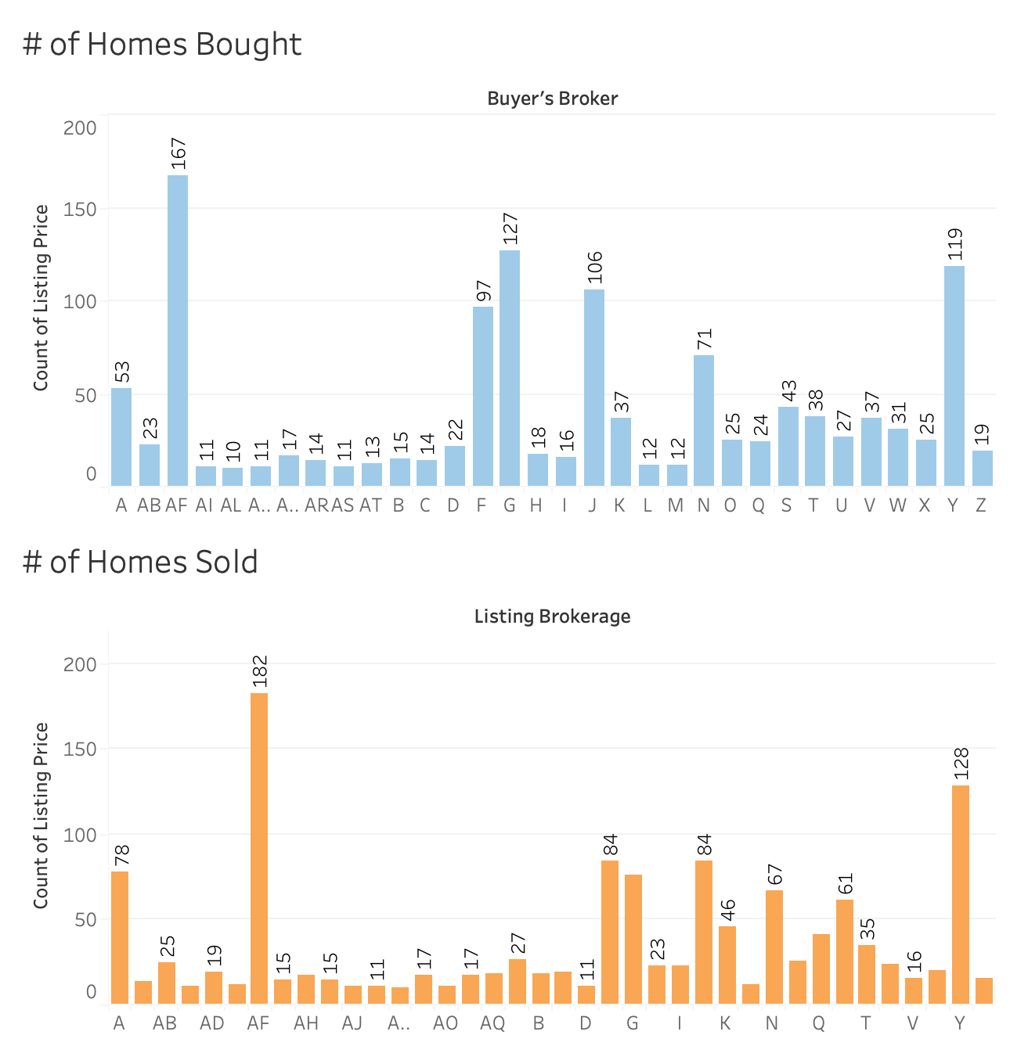
Overall Sales in the County

Slide 6
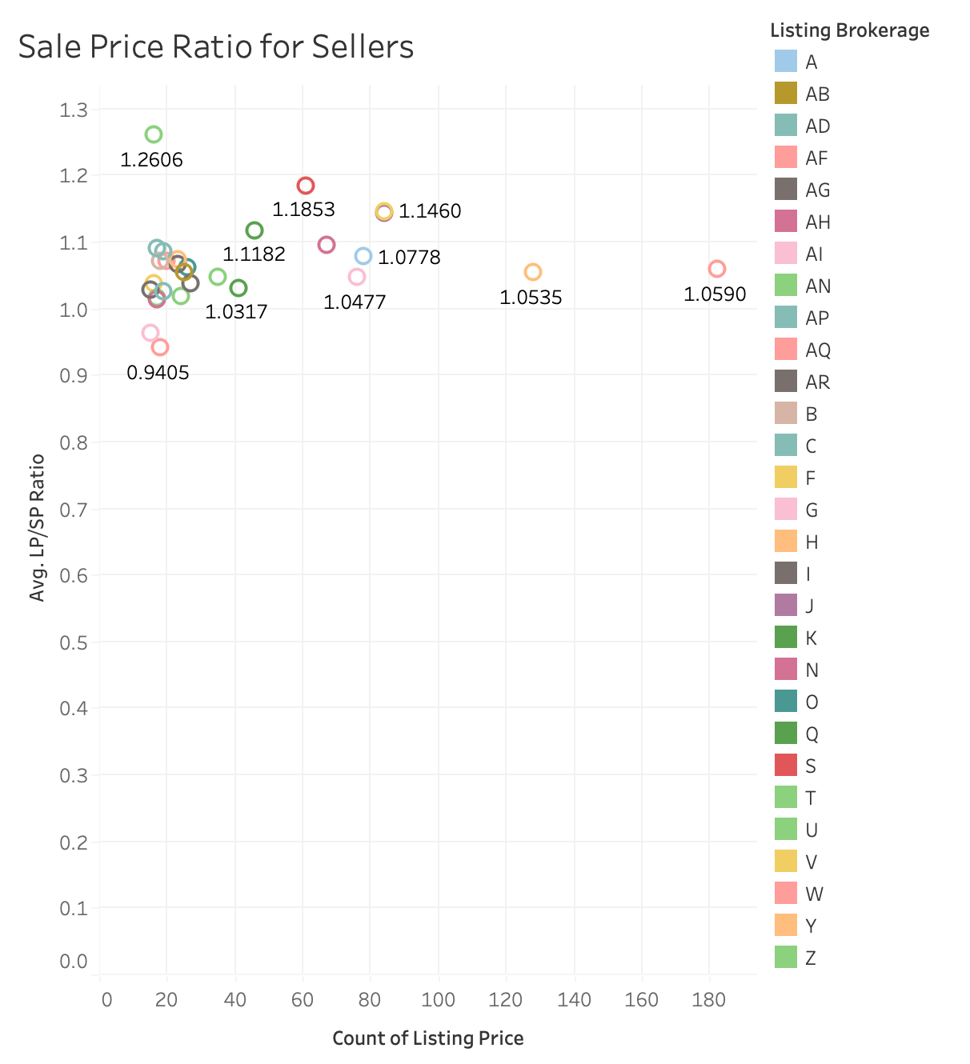
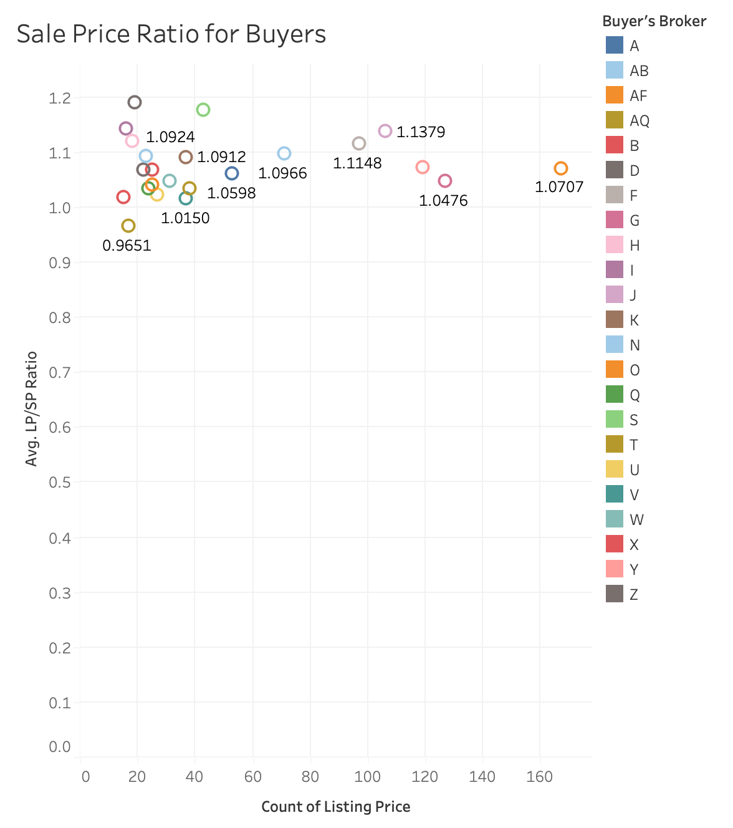
Homes that Sold for Highest/Lowest Price

Slide 7
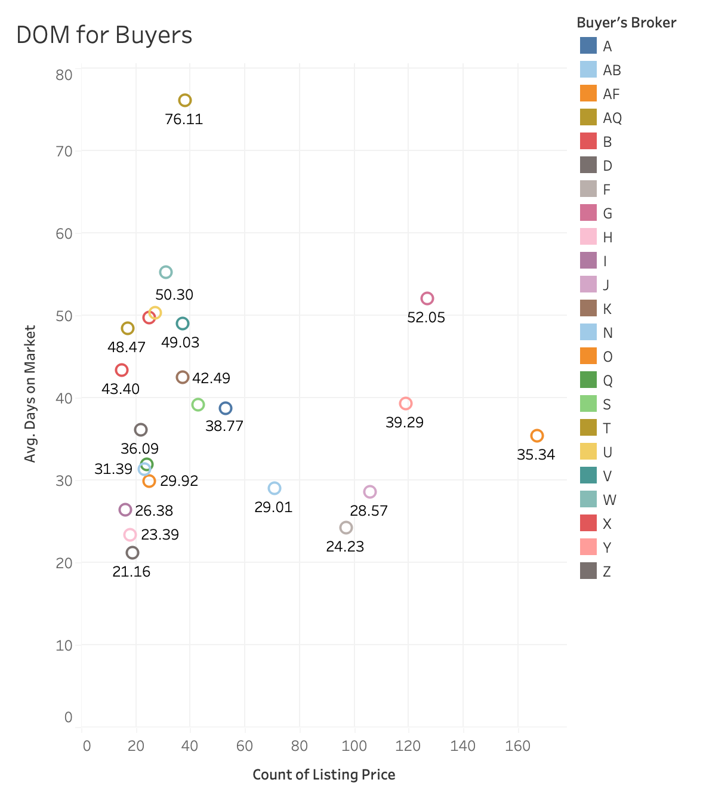
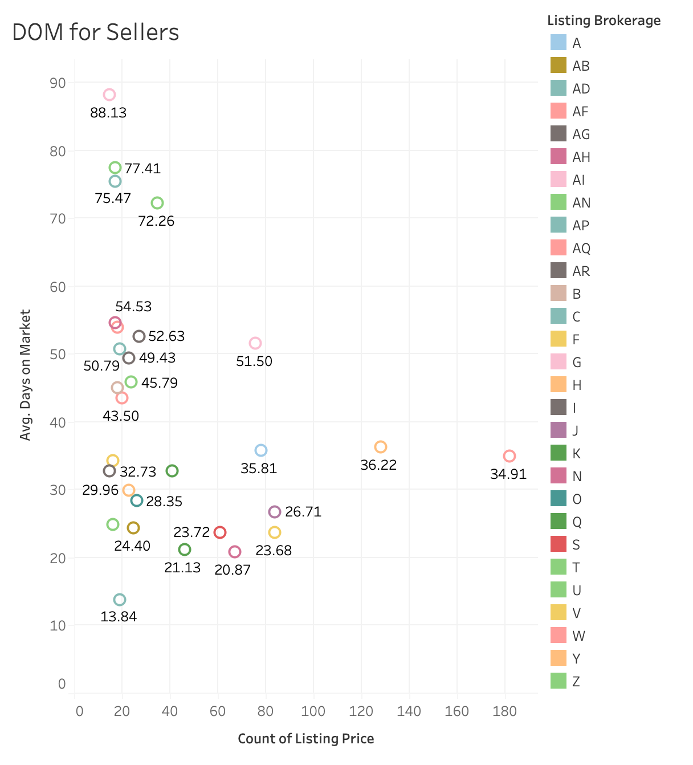
Homes that Sold Quickly/Slowly

Slide 8
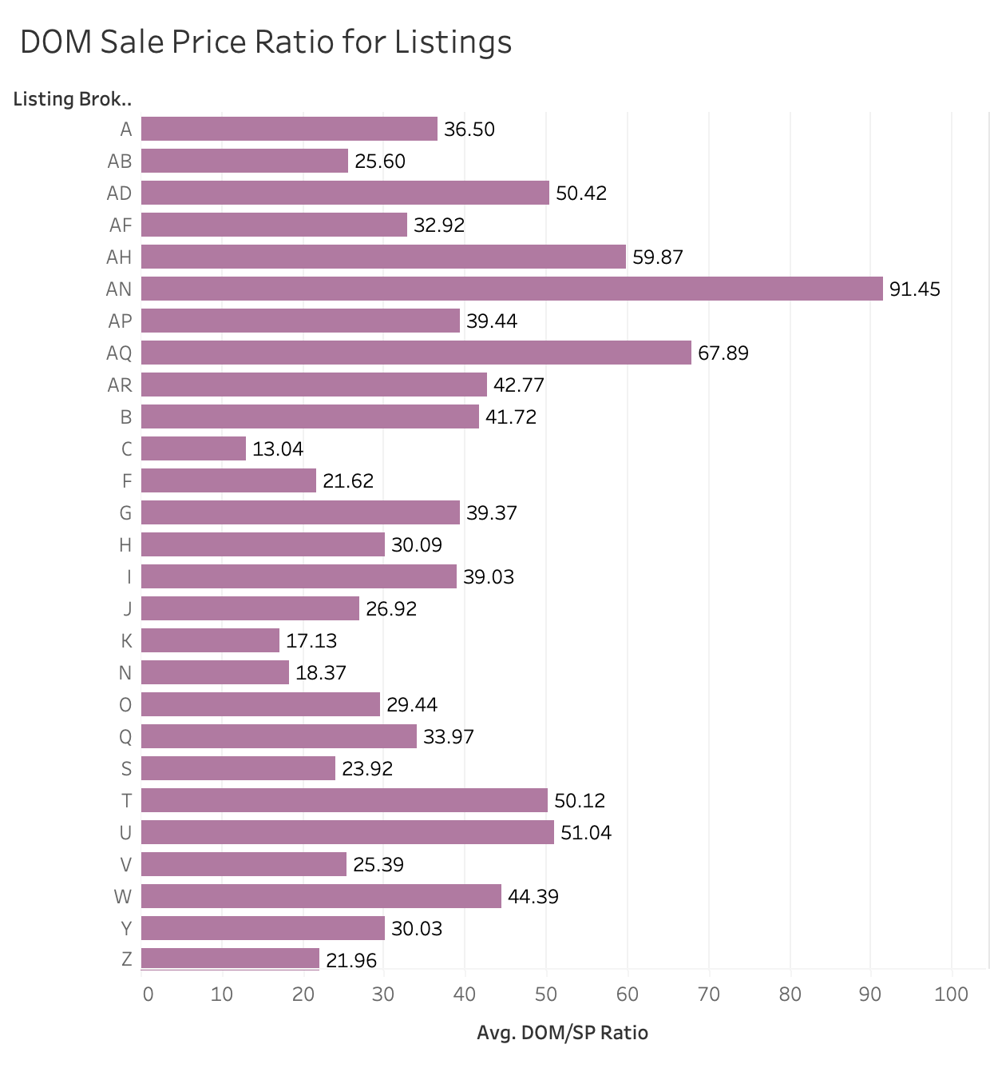
Quick DOM & Highest Price
Quick DOM and Highest Price

Slide 9
Future Work
Compare homes in similar markets
Look at the sales of specific realtors
Look at homes that don’t sell

